Slide 1
MACHINE LEARNING
INTERNSHIP REPORT
Practical Learning • AI/ML Applications • Project Exploration
Ayush Kashyap
InAmigos Foundation
28 August 2026 – 10 September 2026
01 • InAmigos Foundation

Slide 2
Internship at a Glance
A practical introduction to Machine Learning through task-based learning
01 Foundations
Understand how ML systems learn from examples and produce predictions.
02 Applications
Connect ML concepts with familiar real-world applications.
03 Hands-on
Explore a beginner-friendly ML model and its training workflow.
04 Problem Solving
Identify practical problems where AI/ML can improve outcomes.
05 Communication
Build outreach and networking skills through the referral activity.
06 Completion
Successfully completed the Machine Learning Internship program.
02 • InAmigos Foundation

Slide 3
Task 2 — How Machines Learn
Exploring how ML systems learn from examples and make decisions
• Movie recommendation systems learn from viewing history, ratings and similar user preferences.
• Spam detection learns patterns from labelled spam and non-spam messages.
• Face recognition learns visual features from example images.
• The general workflow is: examples → patterns → prediction or decision.
• This task helped build a basic conceptual understanding of Machine Learning.
LEARN
Feed the system examples.
IDENTIFY
Find useful patterns in data.
PREDICT
Use learned patterns on new input.
03 • InAmigos Foundation

Slide 4
Task 3 — Machine Learning Model Exploration
Hands-on exploration of a beginner-friendly model training workflow
• Explored a beginner-friendly ML platform such as Teachable Machine.
• Created a simple recognition model using example data.
• Trained the model using the available examples.
• Tested the trained model with new inputs.
• Observed how the quality and variety of examples affect model performance.
DATA
Collect representative examples.
TRAIN
Let the model learn patterns.
TEST
Check predictions on new inputs.
04 • InAmigos Foundation

Slide 5
Task 4 — AI & ML in the Real World
Identifying real-world problems and suitable AI/ML approaches
AGRICULTURE
Predict crop disease and optimize irrigation using sensor or image data.
HEALTHCARE
Support early detection and prioritize cases using medical data.
EDUCATION
Personalize learning content using student performance data.
TRANSPORTATION
Predict traffic patterns and support better route planning.
ENVIRONMENT
Monitor pollution, waste and environmental changes using data.
EXPECTED BENEFIT
Faster analysis, better predictions, early warnings and smarter decisions.
05 • InAmigos Foundation

Slide 6
AI/ML Solution Pipeline
A simple framework for turning a real-world problem into a data-driven solution
01 Problem
Define the real-world challenge.
02 Data
Collect and prepare relevant data.
03 Model
Train an ML model to learn patterns.
04 Evaluate
Test accuracy and reliability.
05 Use
Apply predictions with human oversight.
Key principle: AI should support responsible decisions, with attention to data quality, privacy, bias and human review.
06 • InAmigos Foundation

Slide 7
Key Learning Outcomes
Skills and understanding developed during the internship
• Understood the fundamentals of how ML models learn from examples.
• Connected ML concepts with everyday applications.
• Gained hands-on exposure to training and testing a simple model.
• Learned to identify AI/ML opportunities in real-world problems.
• Improved solution-oriented and practical thinking.
• Strengthened communication and networking through outreach.
• Recognized the importance of data quality and evaluation.
• Built a foundation for deeper study of AI and Machine Learning.
09 • InAmigos Foundation

Slide 8
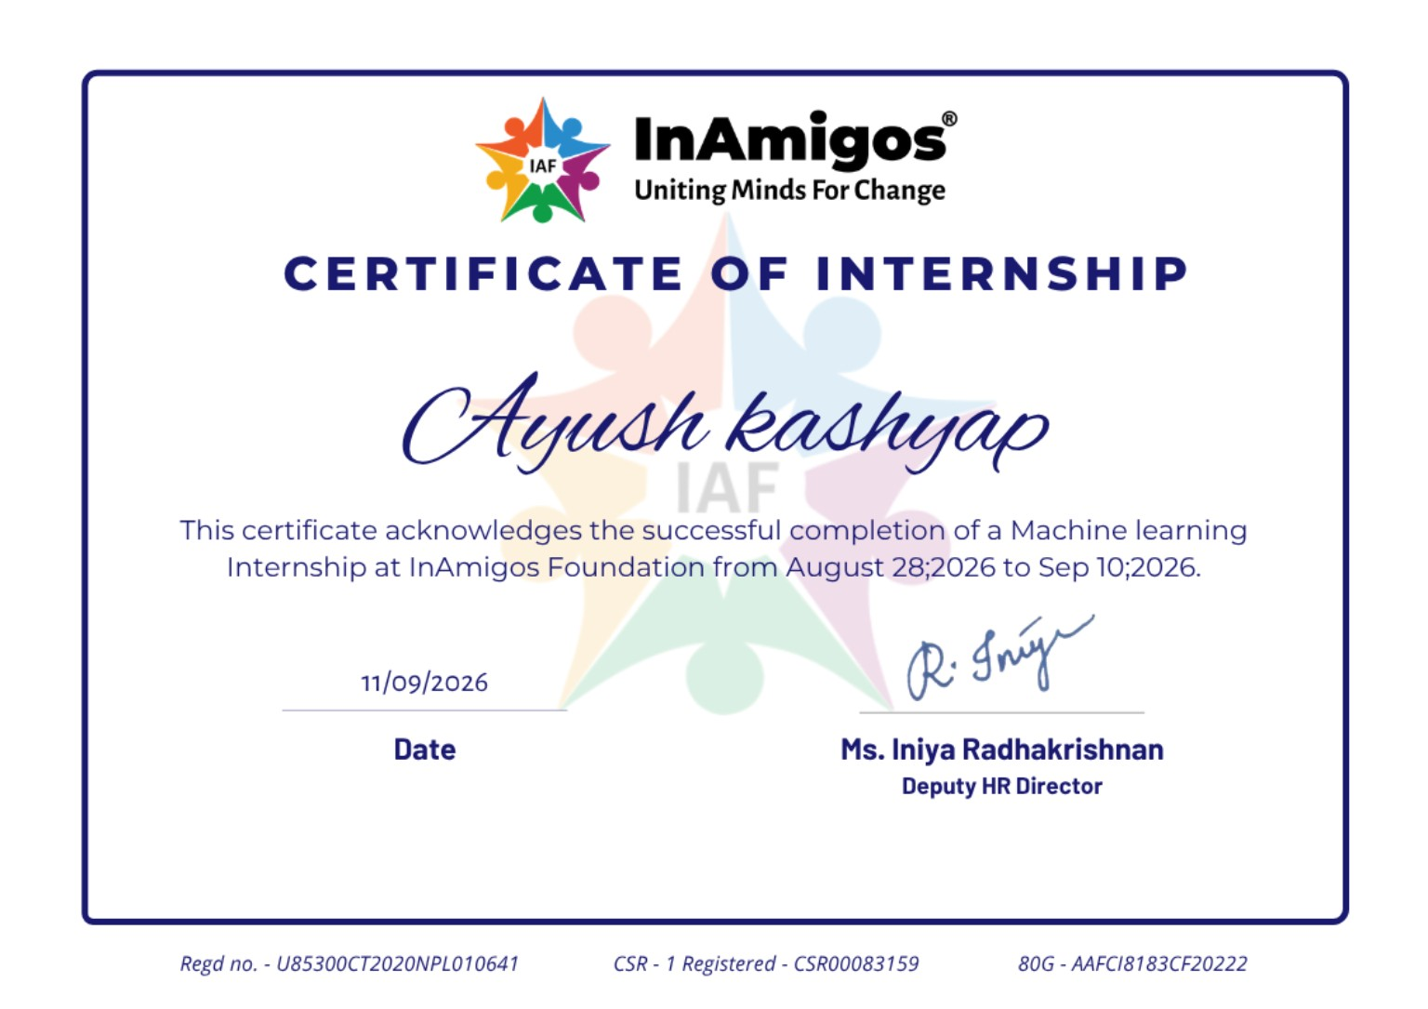
Certificate of Internship
Official certificate of successful completion
10 • InAmigos Foundation

Slide 9
THANK YOU
Machine Learning Internship
Ayush Kashyap • InAmigos Foundation
11 • InAmigos Foundation

